Slide 1
Reinforcement Learning
Tan Wen Tao Bryan (2214449)
Ryan Yeo (2214452)
DAAA/FT/2B/01

Slide 2
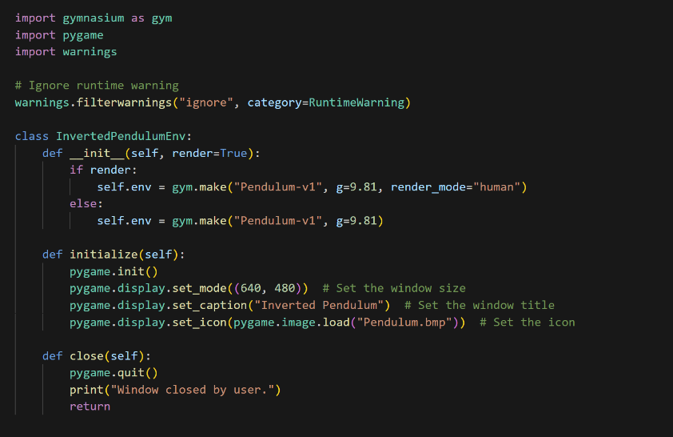
Setting up the Environment

Slide 3
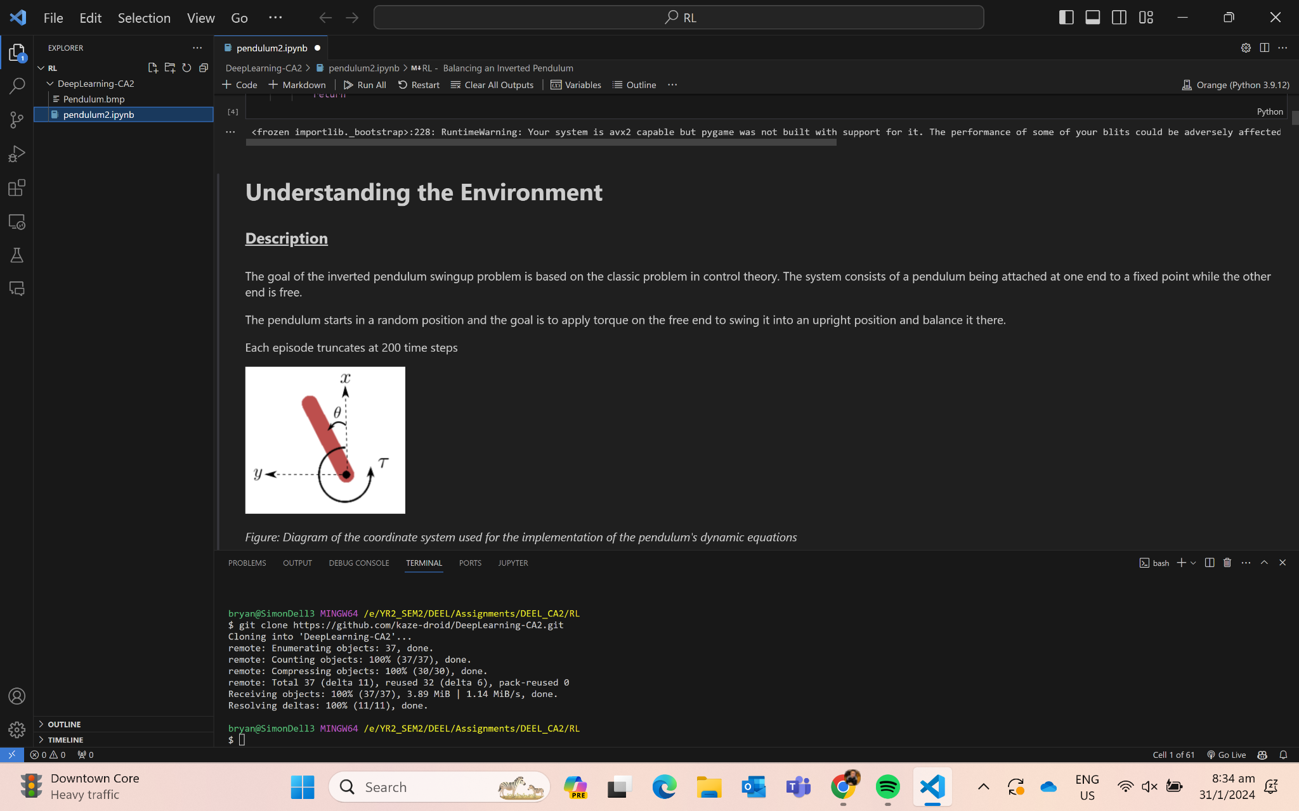
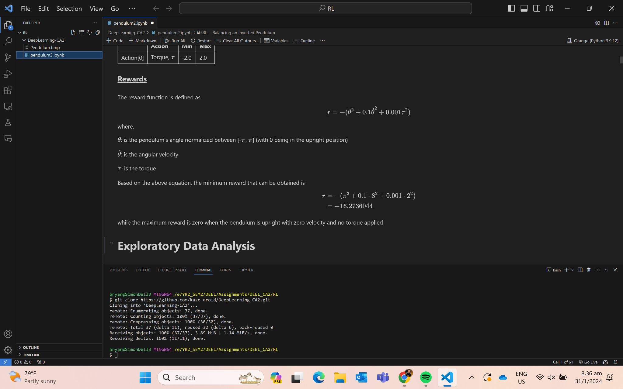
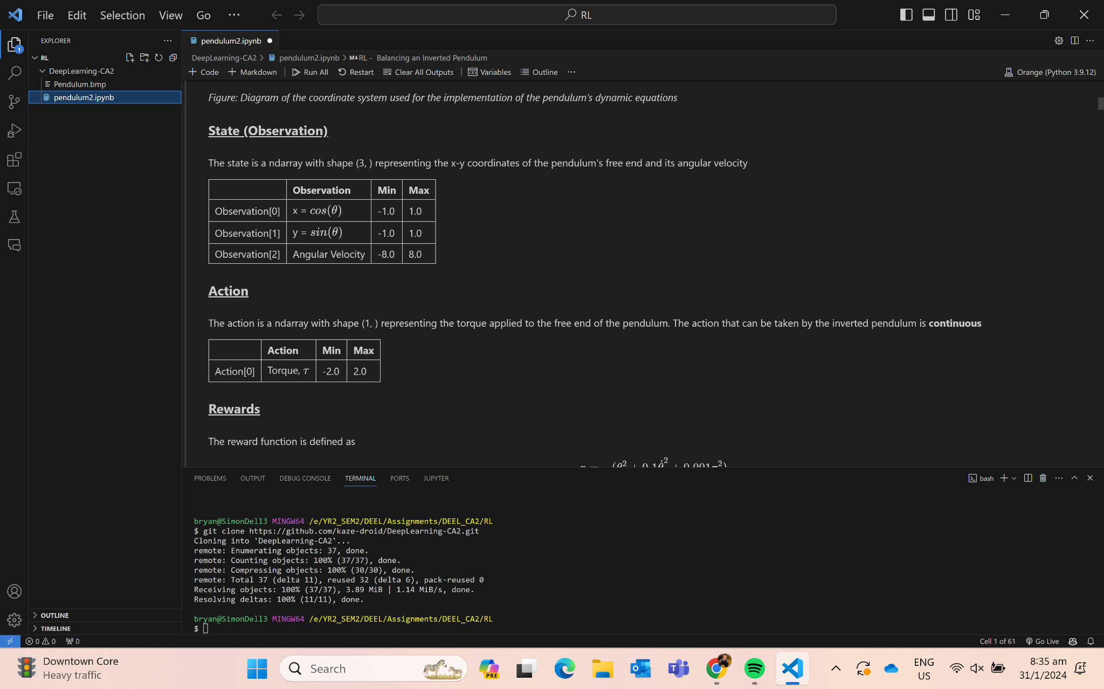
Background Information

Slide 4
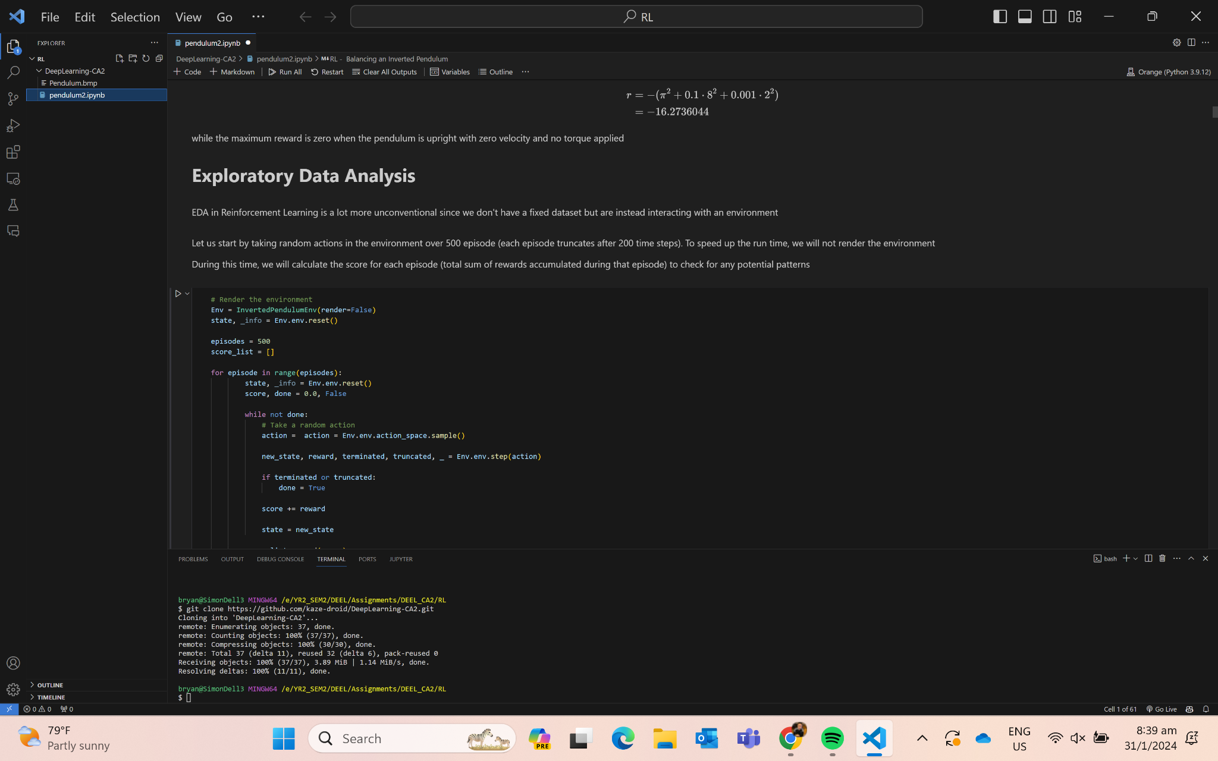
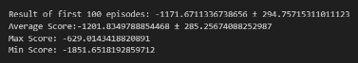
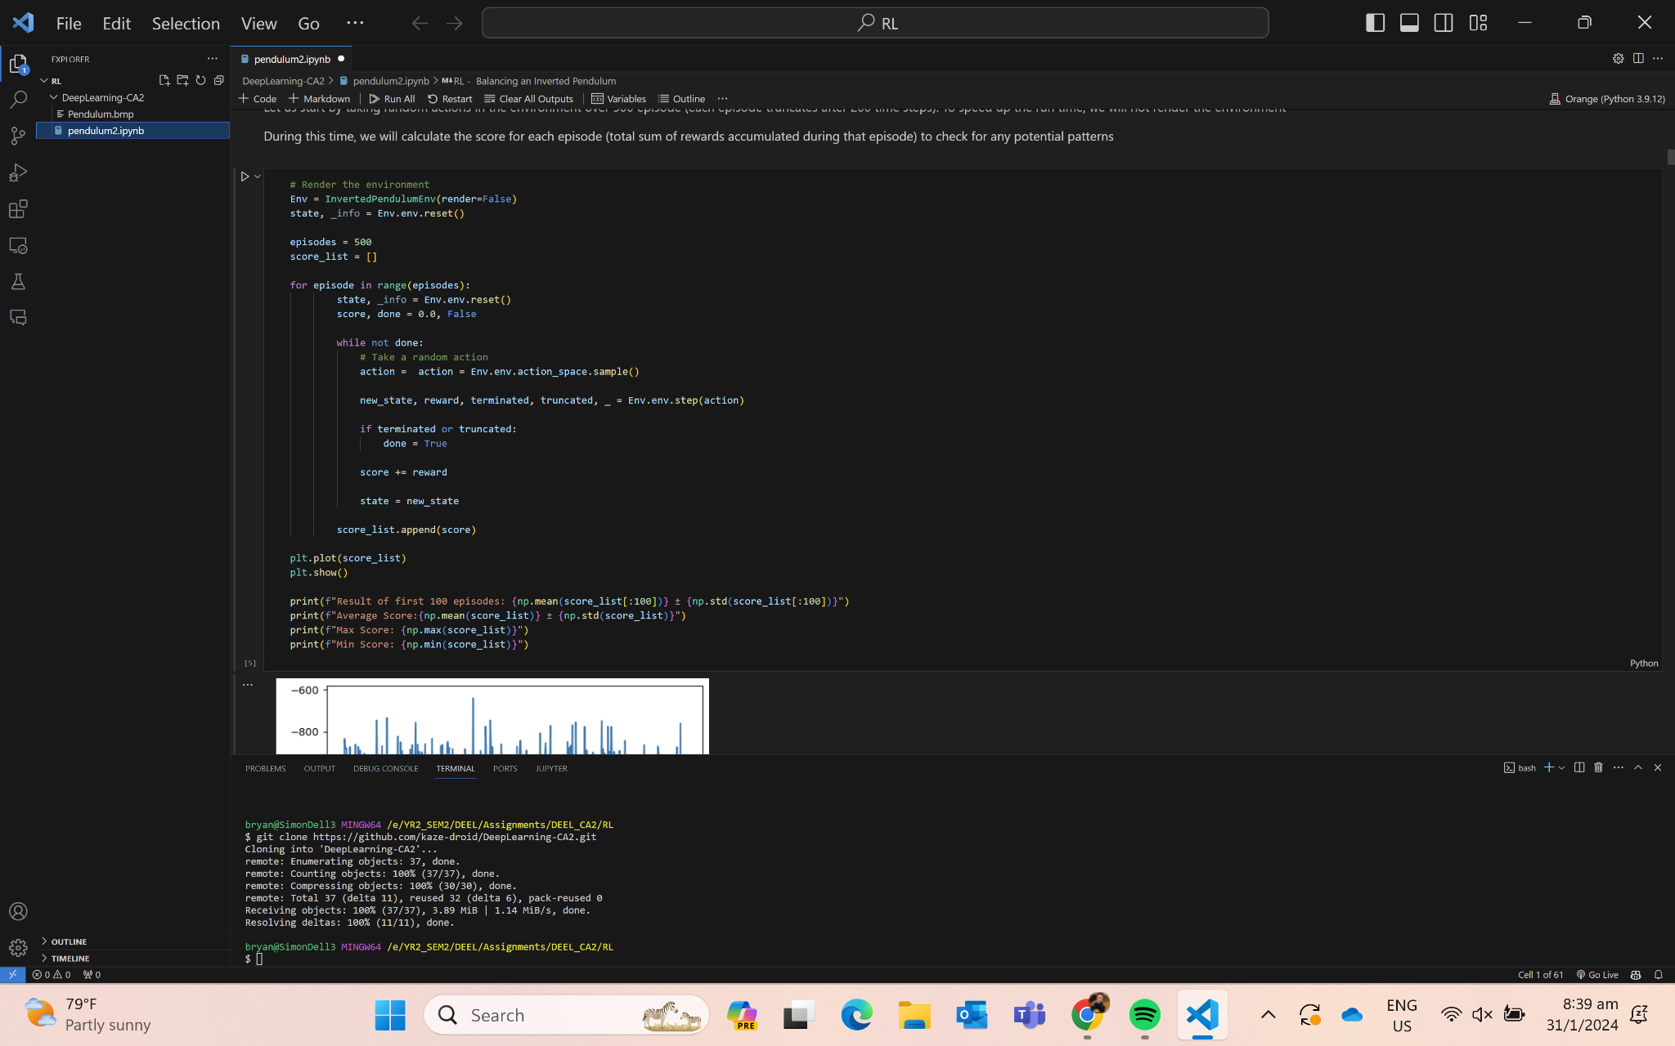
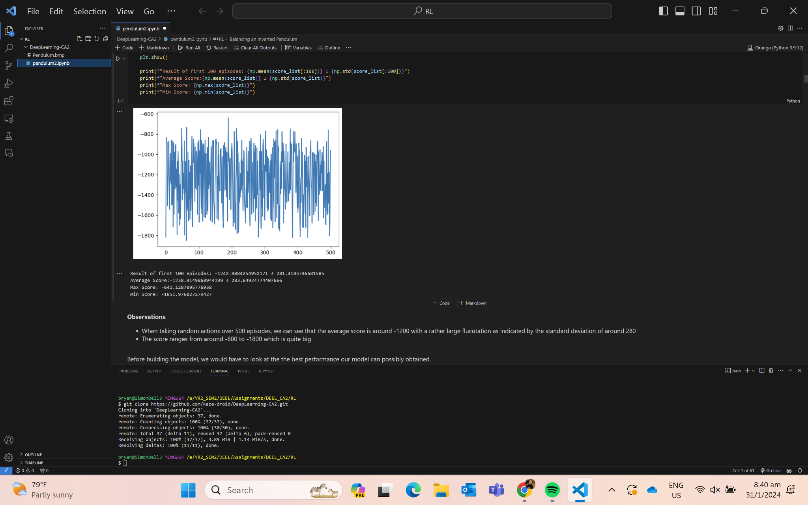
EDA
Allow random actions to happen in the environment over 500 episodes

Slide 5
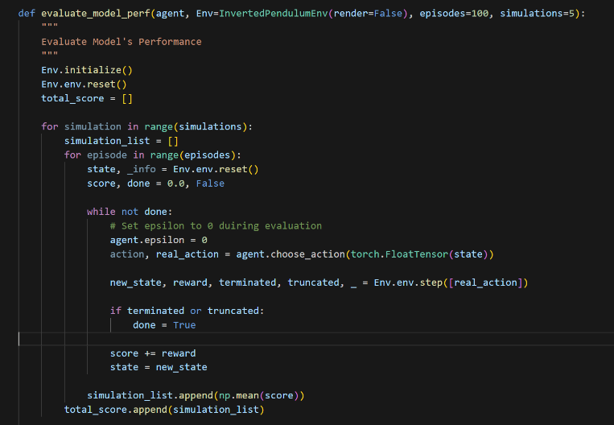
Evaluating the Model’s Performance
Each 100 episode mean is called a “simulation” and we will run 10 simulations to obtain the mean performance of the agent over a 100 episodes
Obtain the mean score (sum of rewards per episode) over 100 episodes

Slide 6
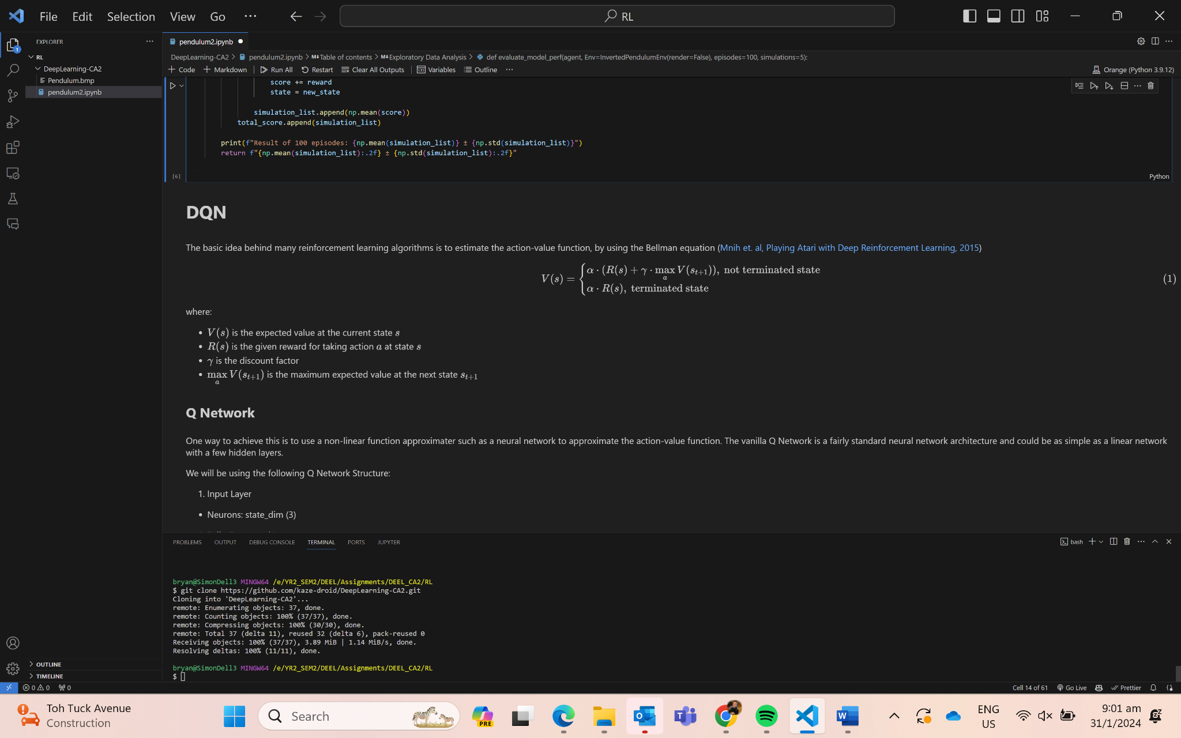
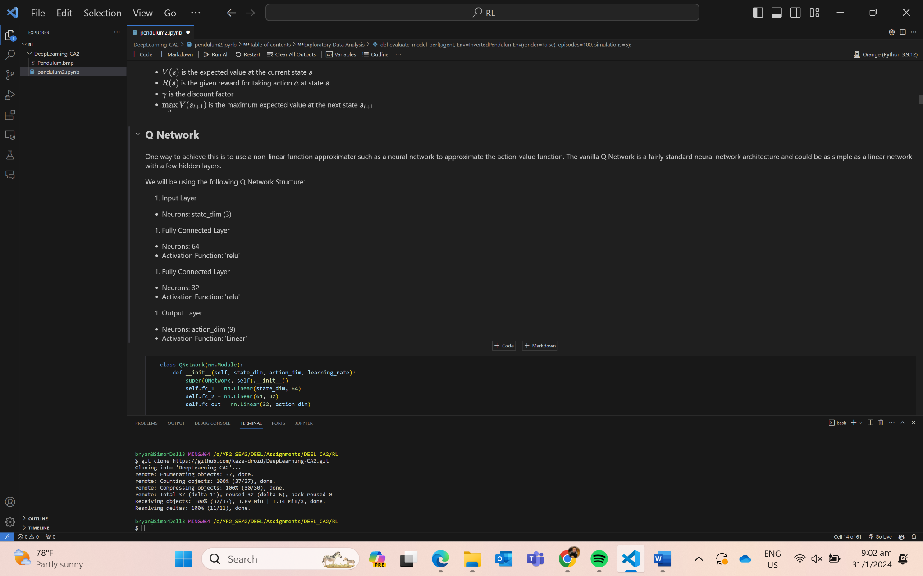
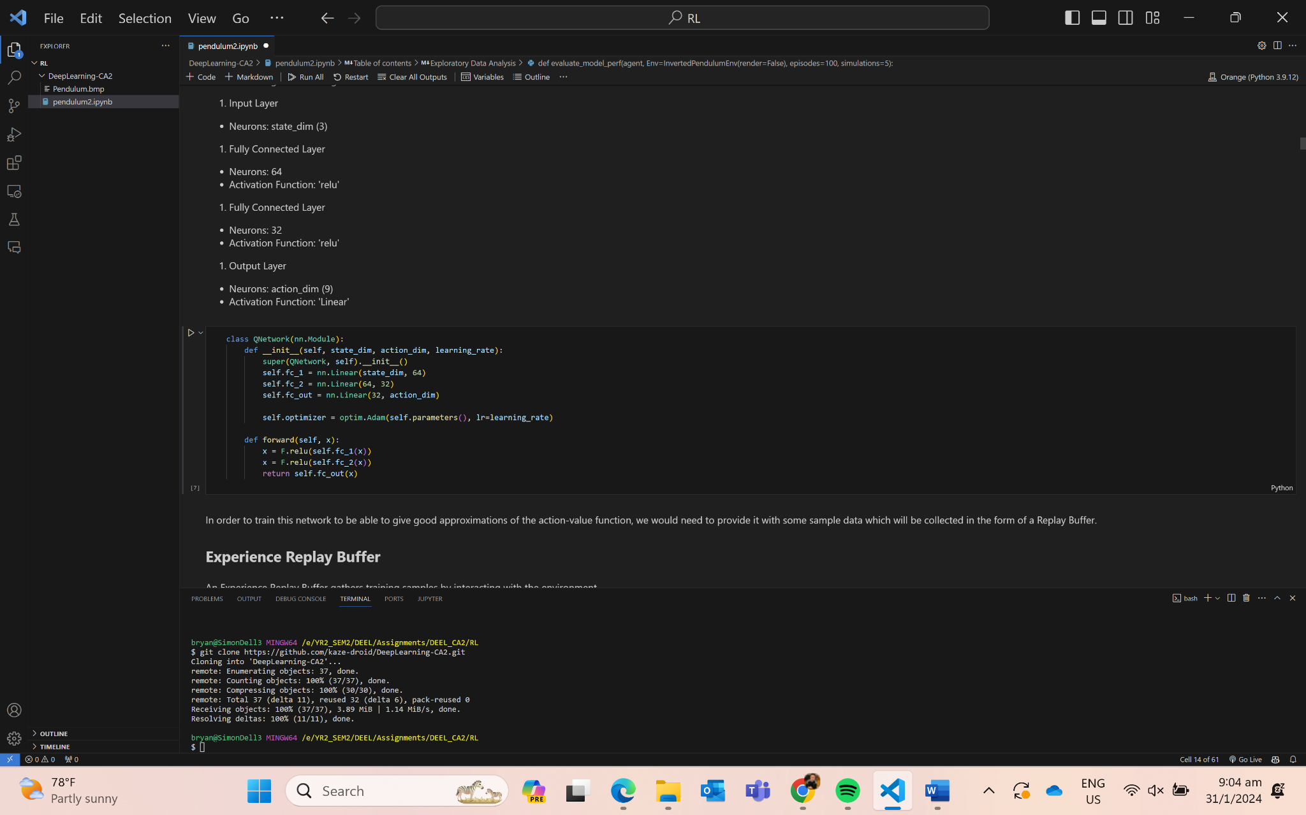
DQN (Q-Network)

Slide 7
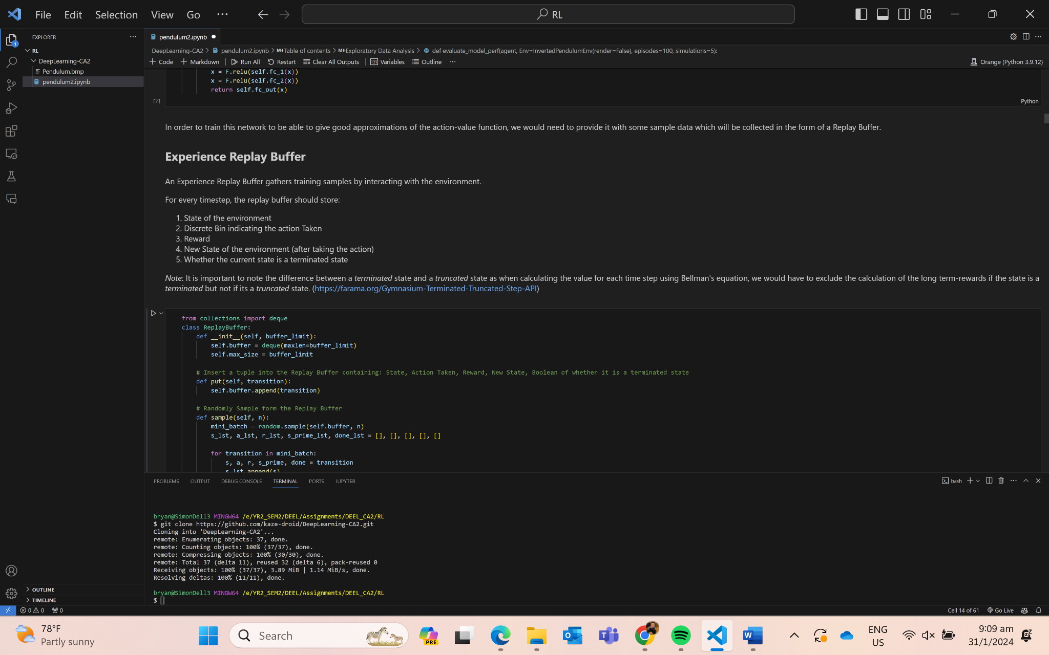
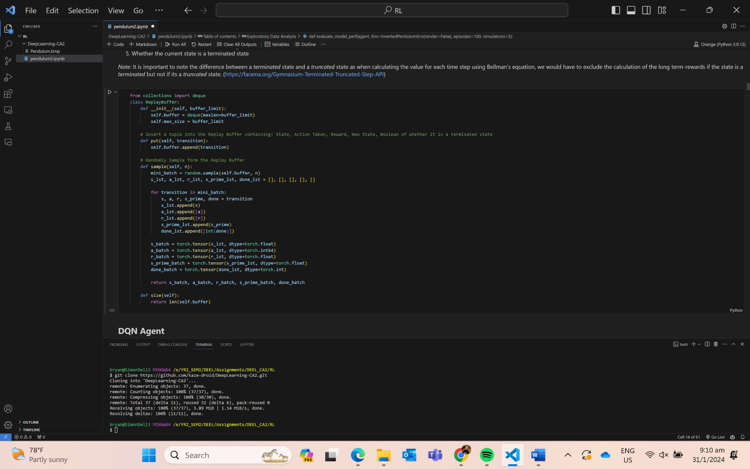
DQN (Replay Buffer)

Slide 8
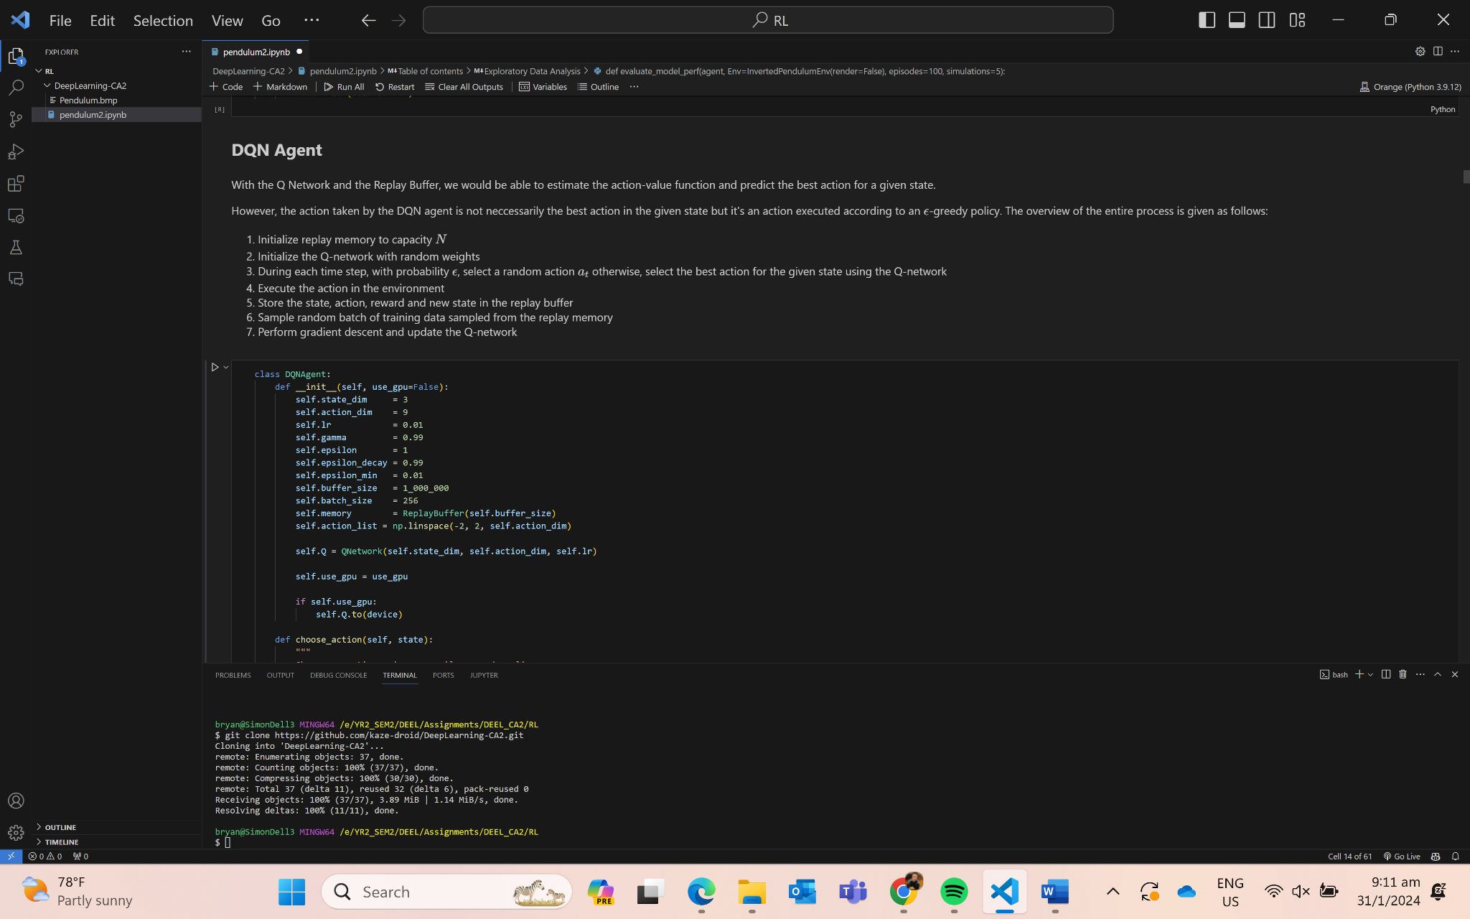
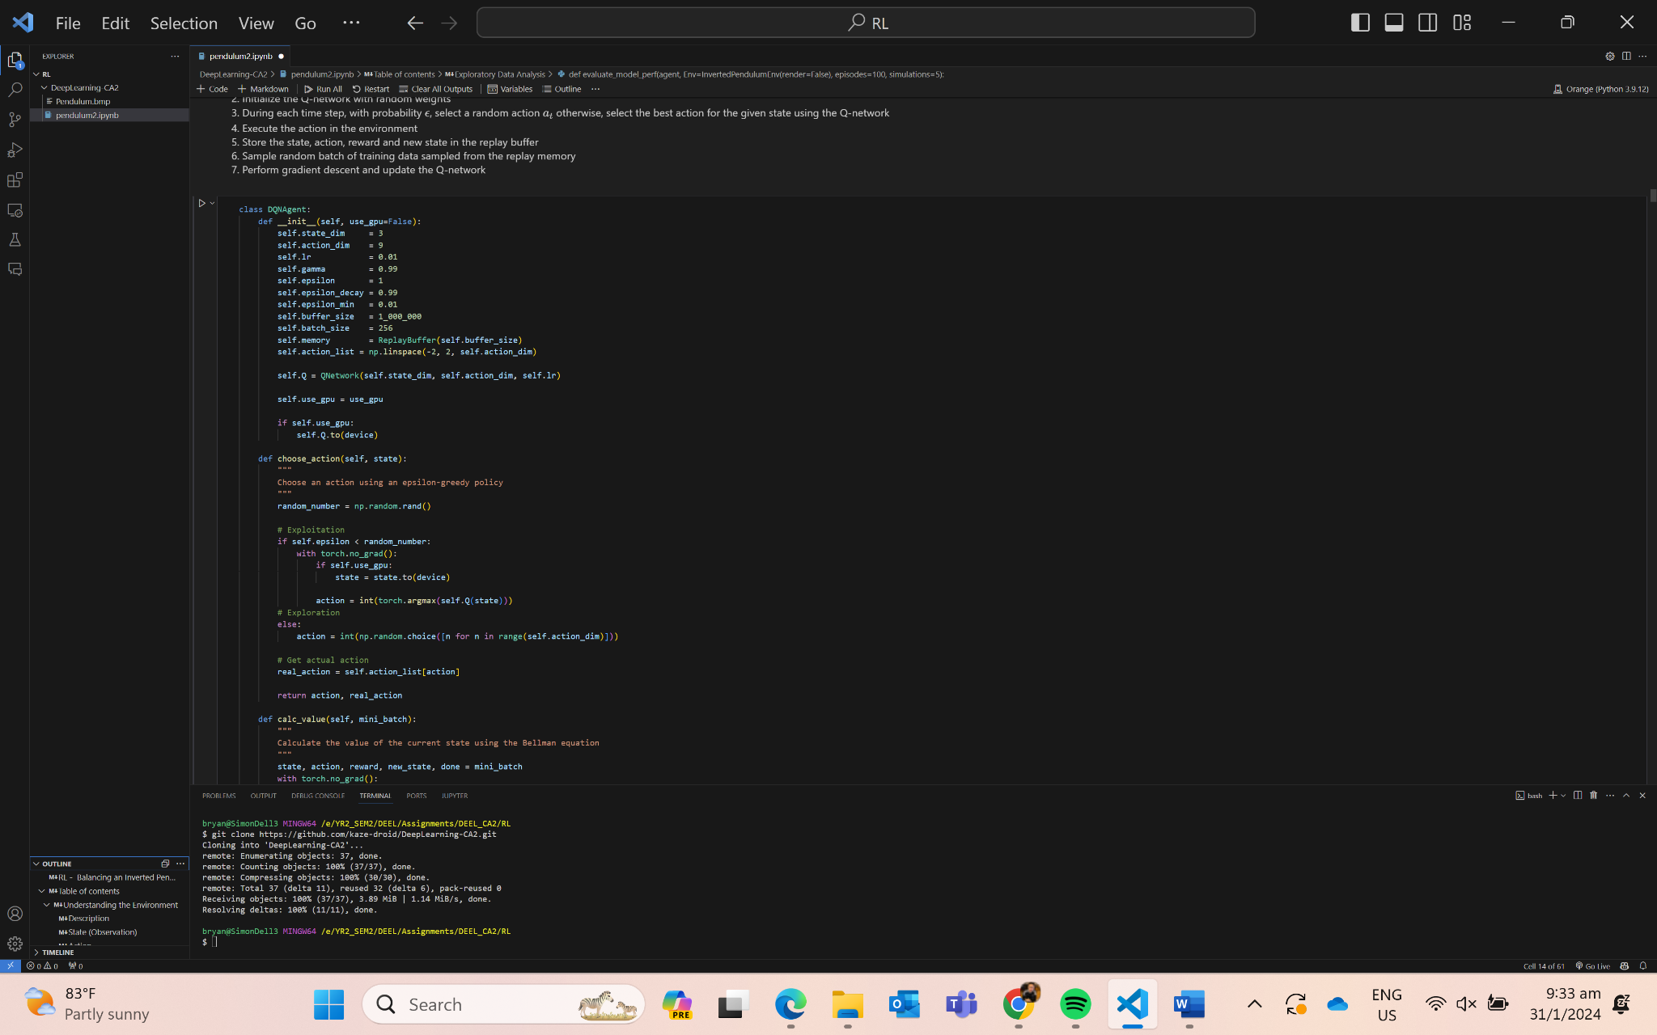
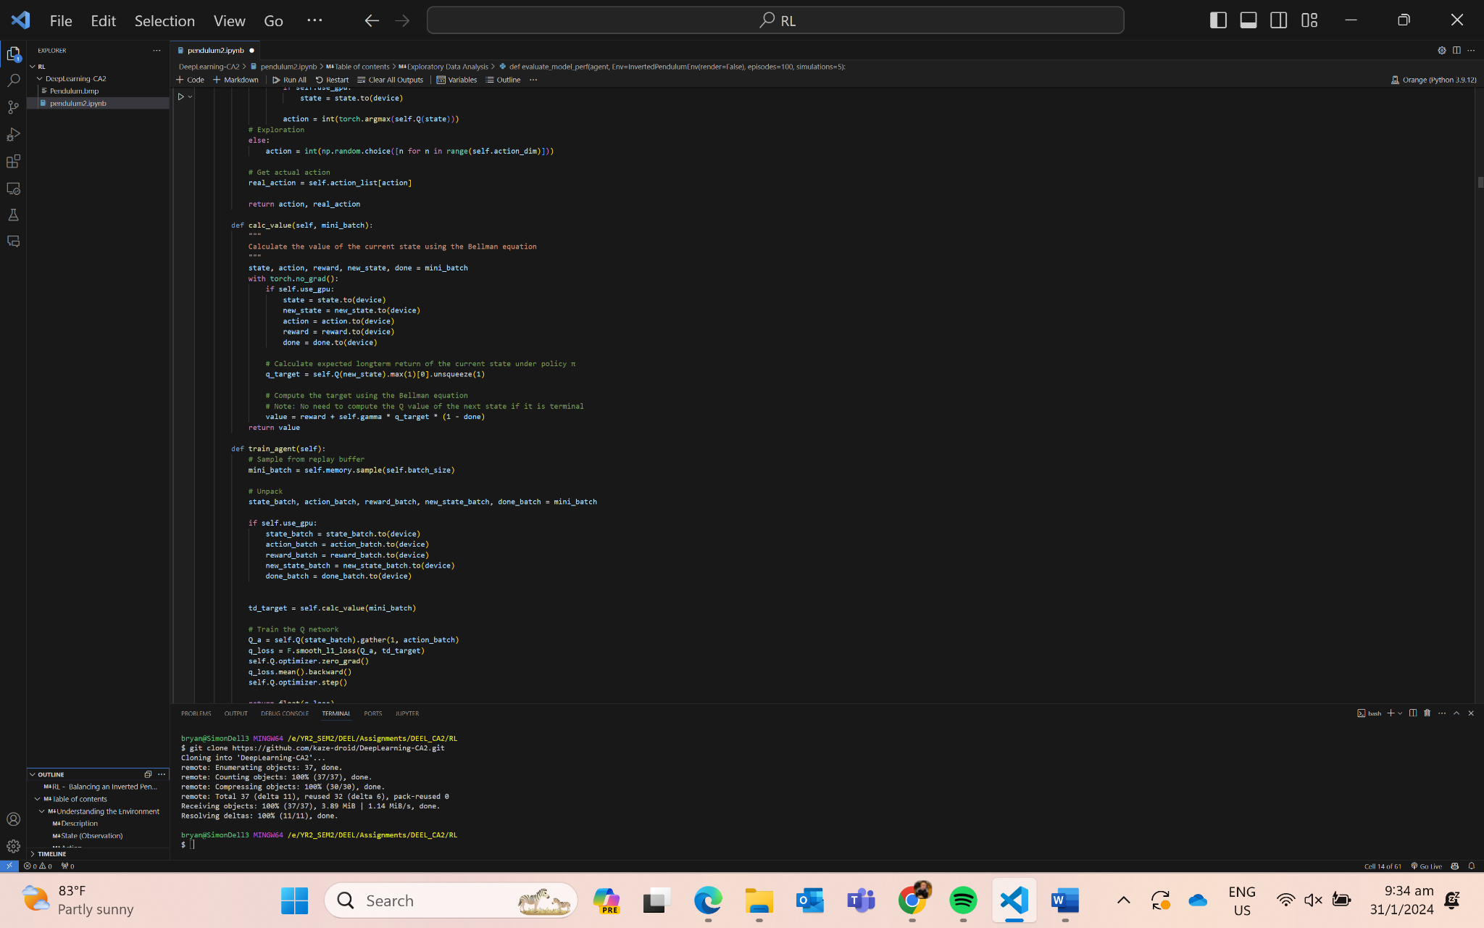
DQN (Agent)

Slide 9
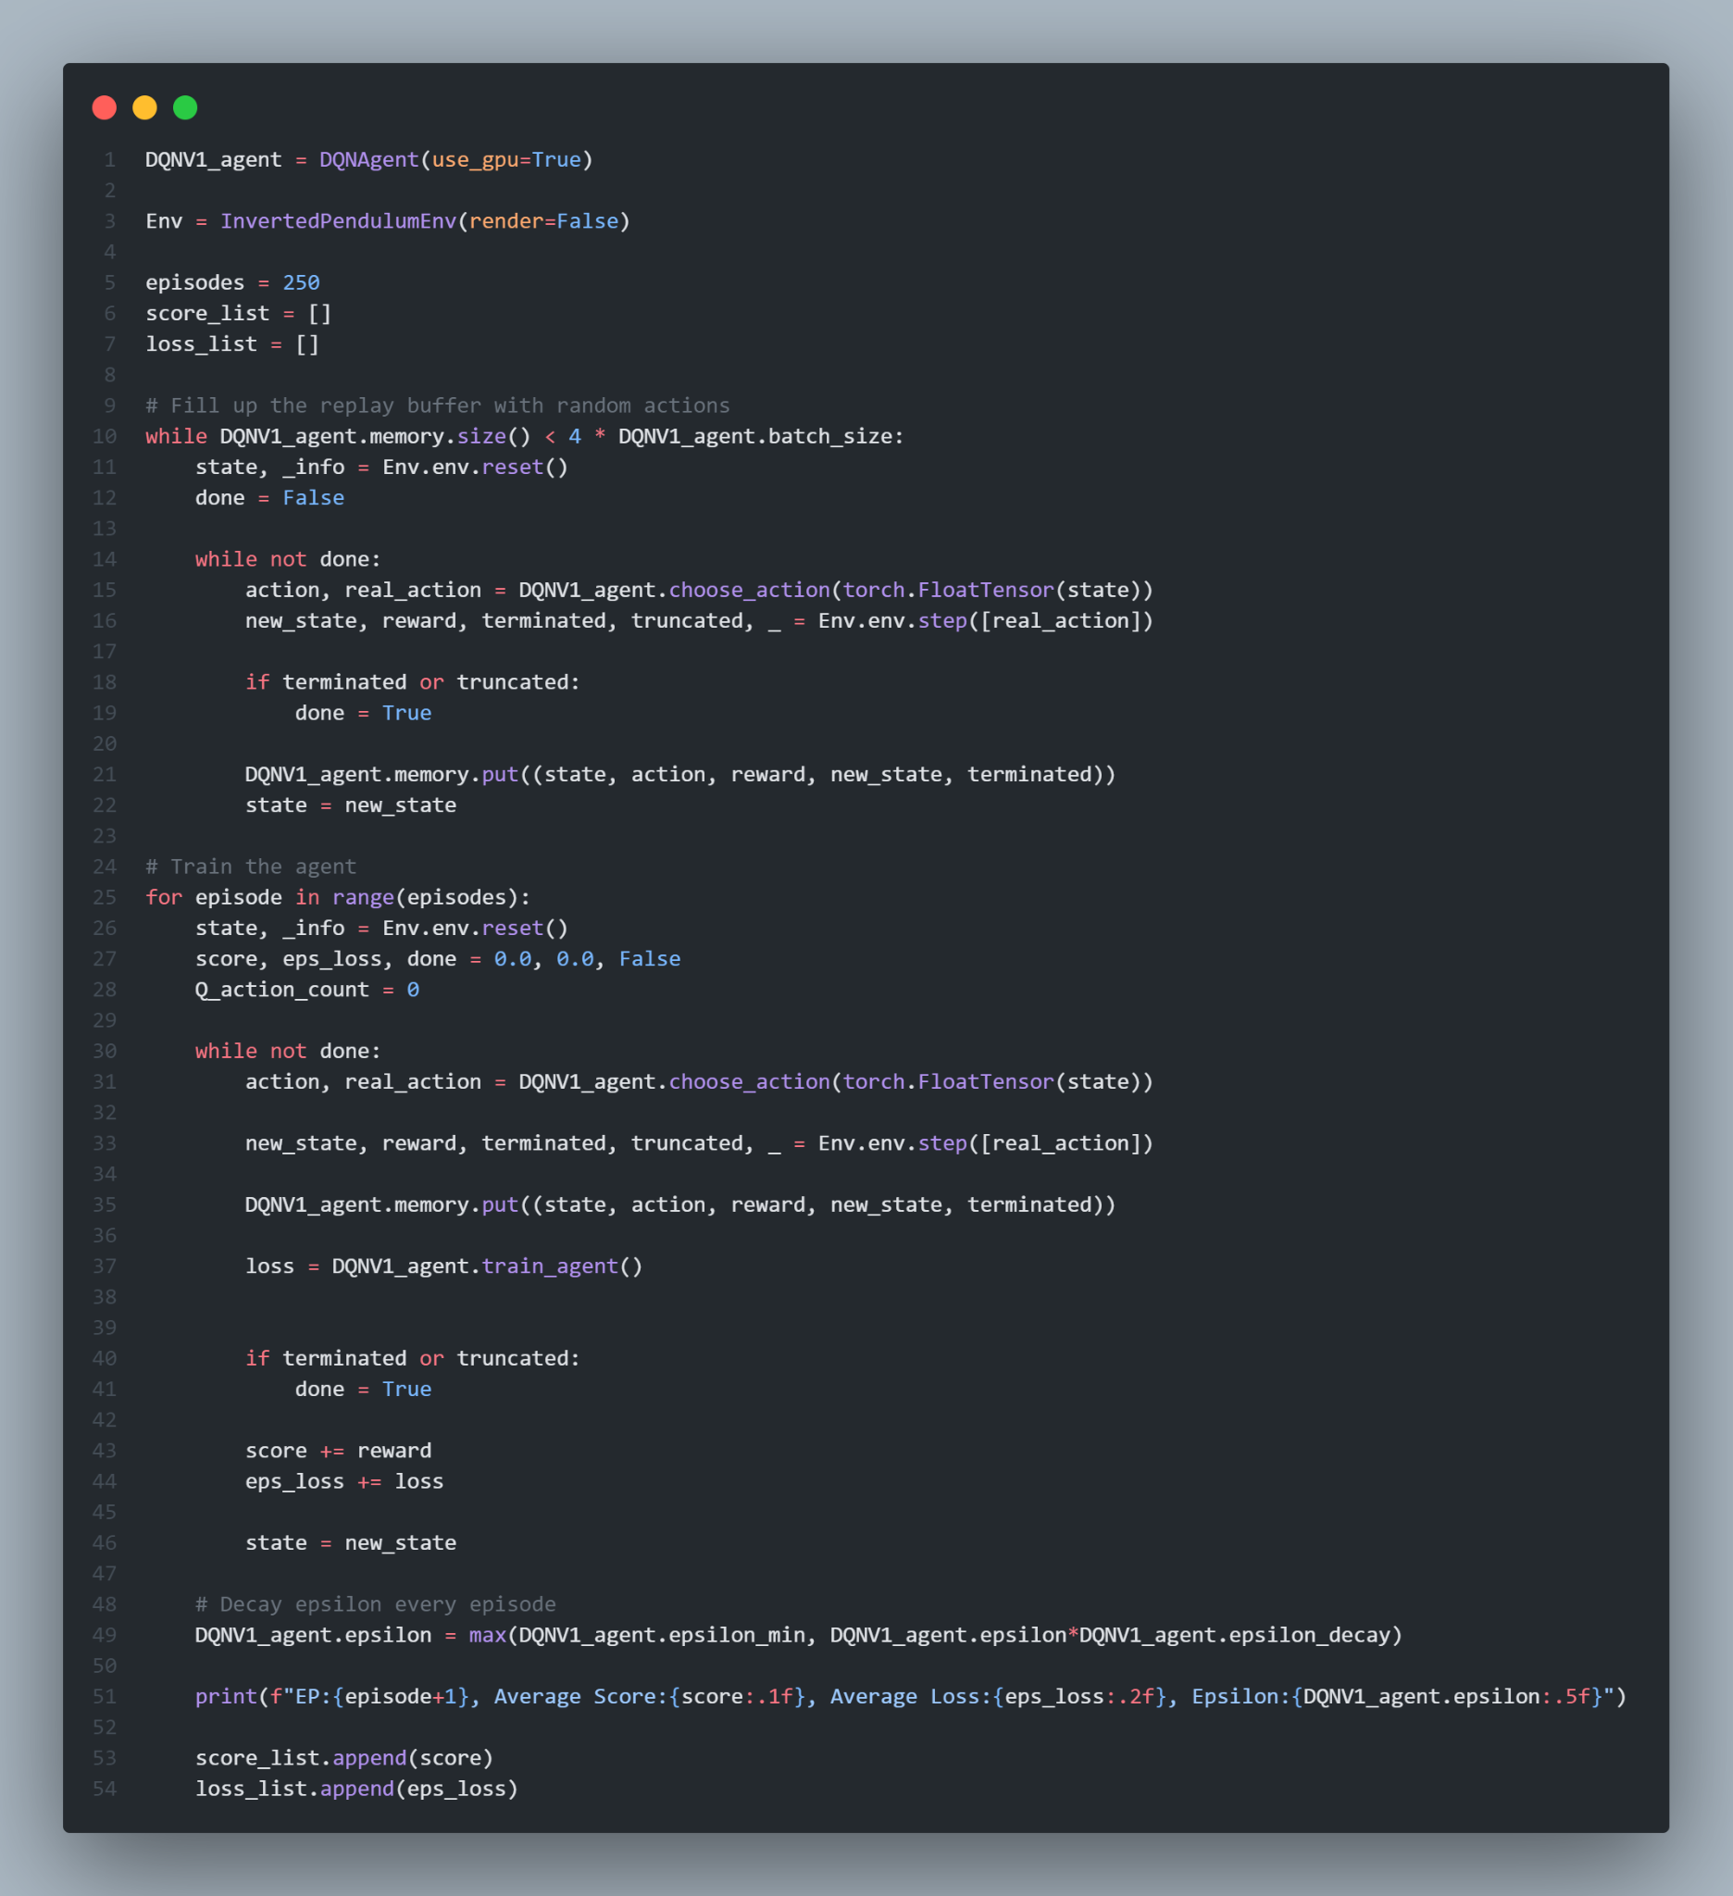
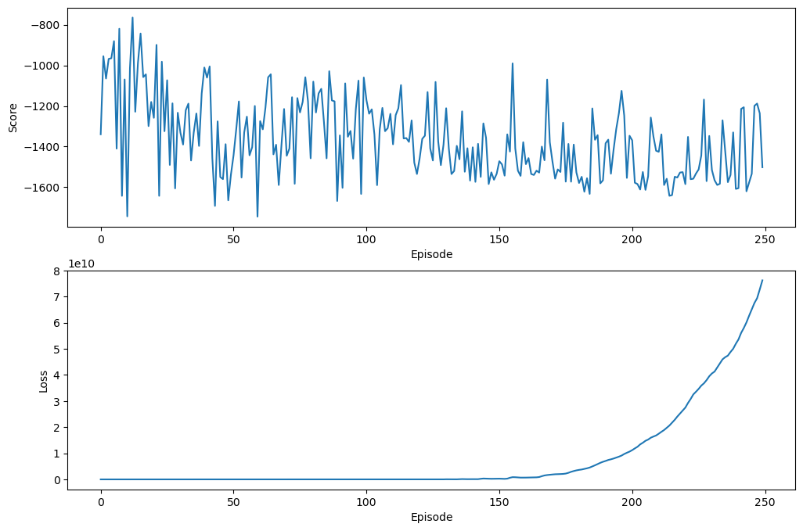
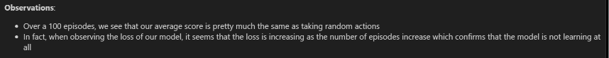
DQNV1 (Training + Evaluation)
Result of 100 episodes: -1399.2889424982893 ± 246.07144174247648

Slide 10
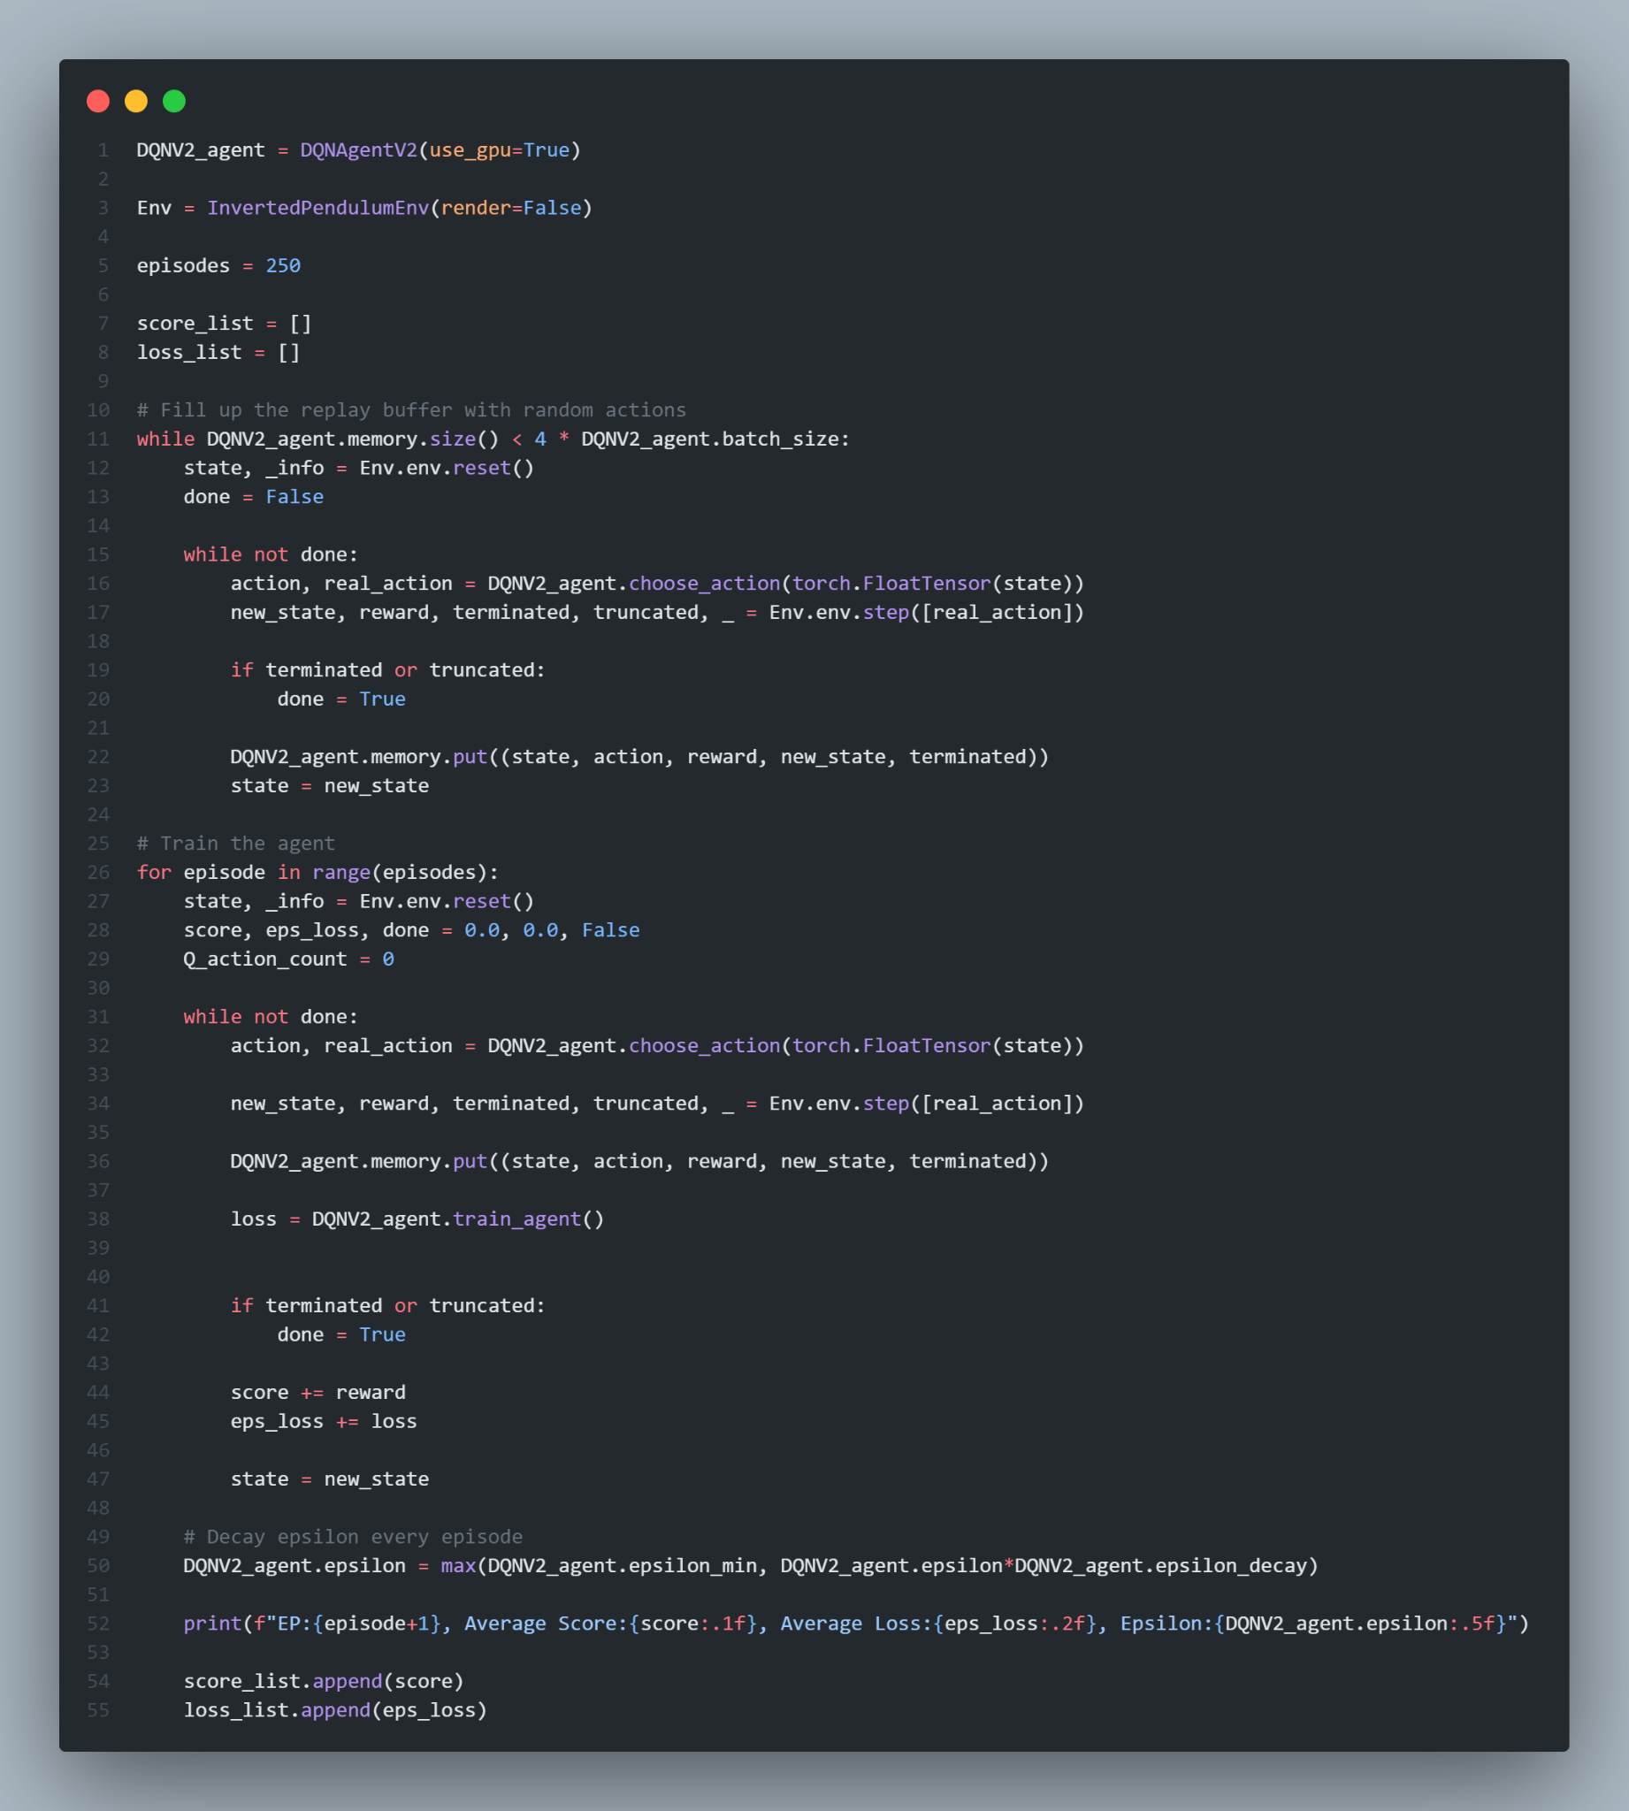
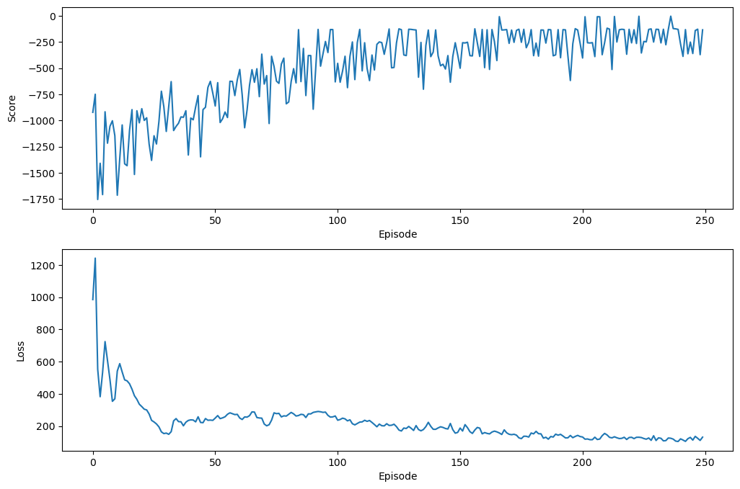
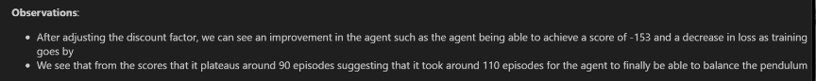
DQNV2 (Training + Evaluation)
Result of 100 episodes: -153.2746744281979 ± 100.51275779188158
Hyperparameter Tuning:
Gamma: 0.99 -> 0.95
Learning Rate: 0.01 -> 0.001

Slide 11
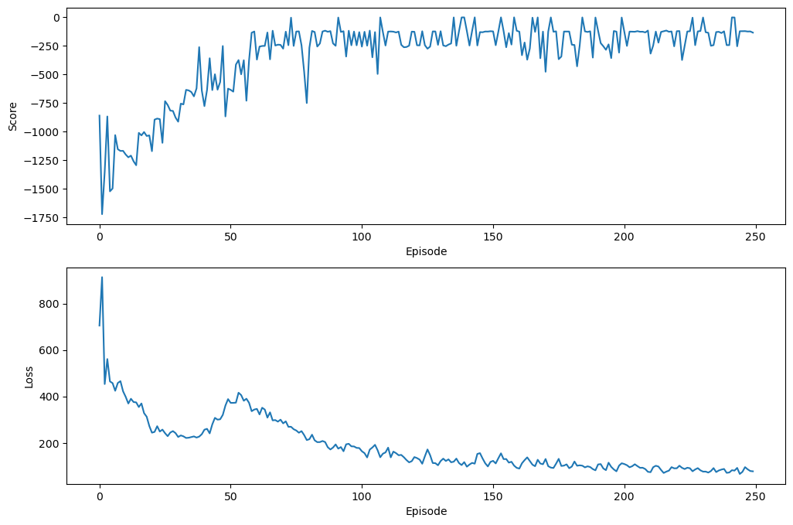
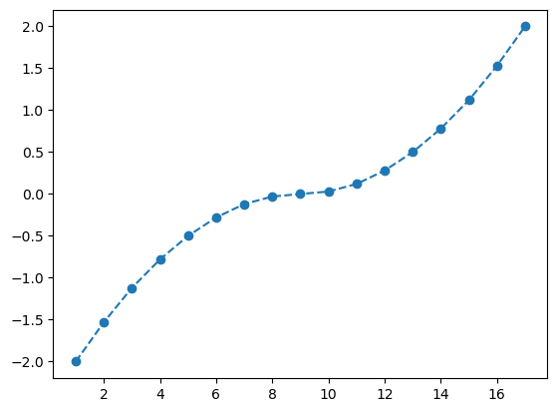
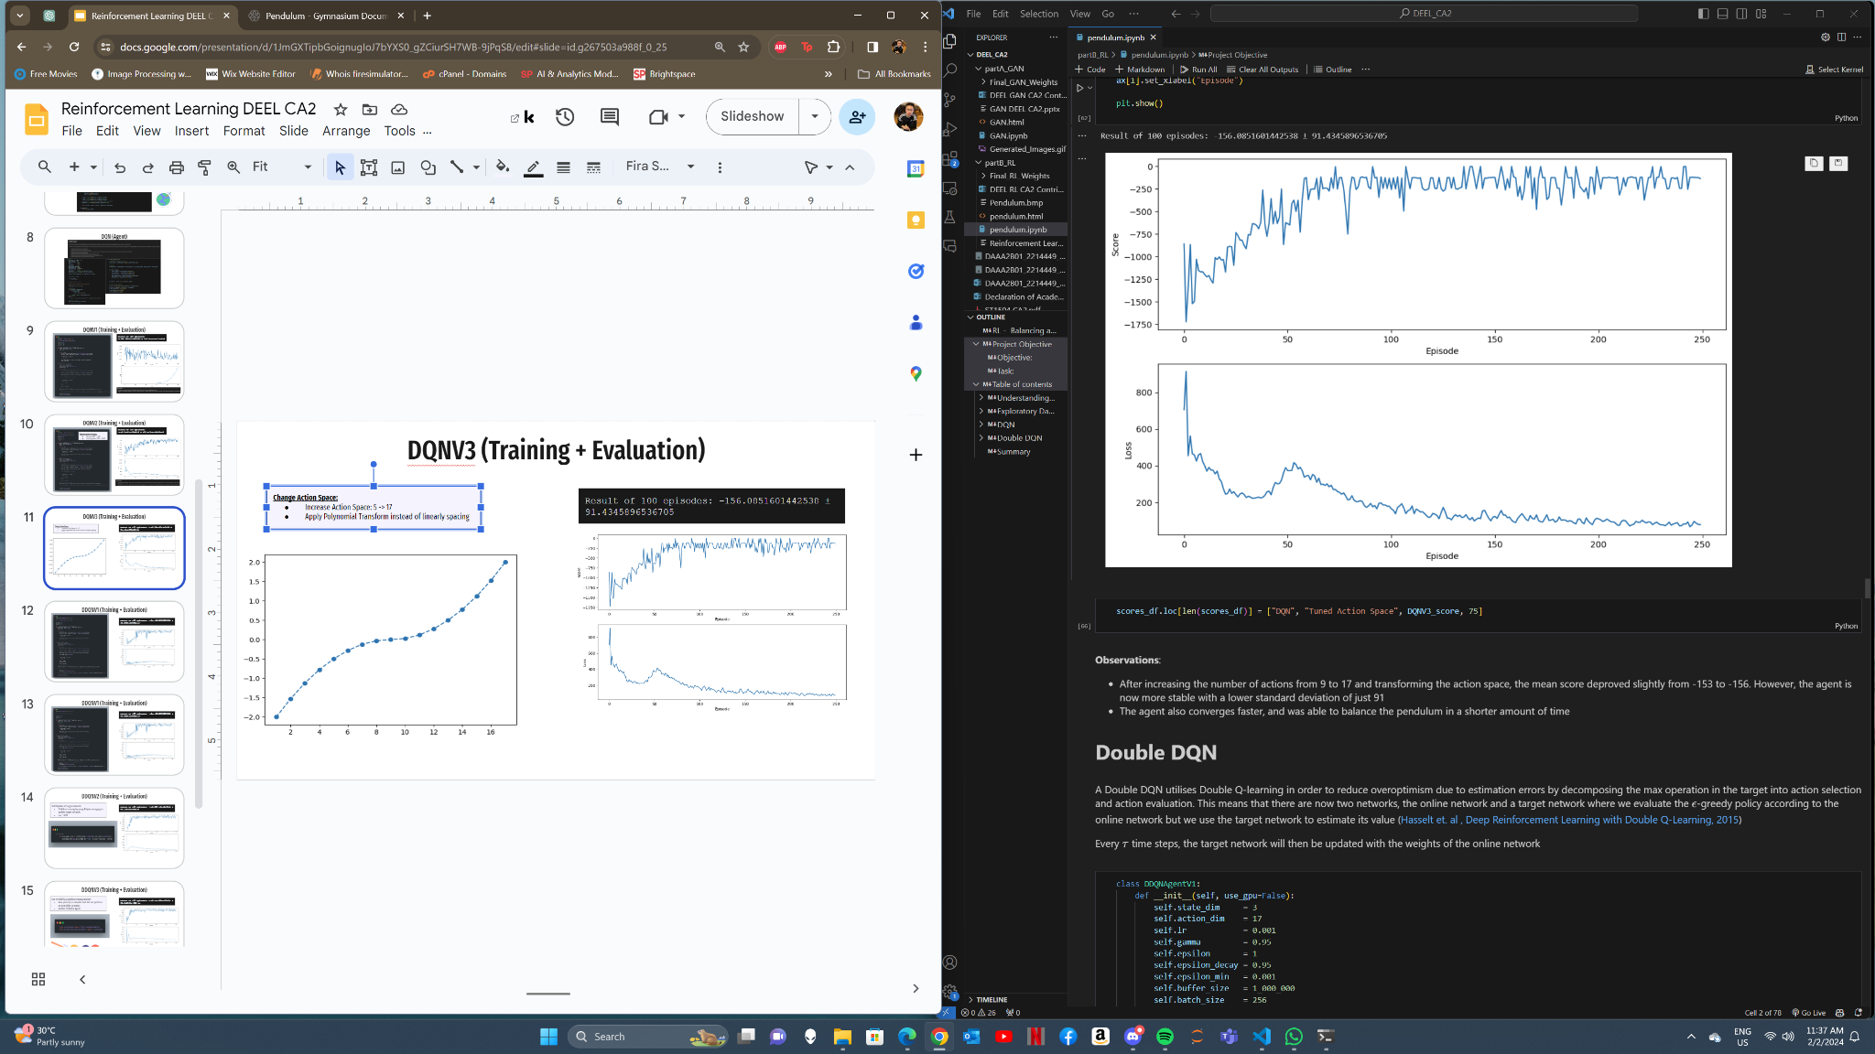
DQNV3 (Training + Evaluation)
Change Action Space:
Increase Action Space: 5 -> 17
Apply Polynomial Transform instead of linearly spacing
Result of 100 episodes: -156.0851601442538 ± 91.4345896536705

Slide 12
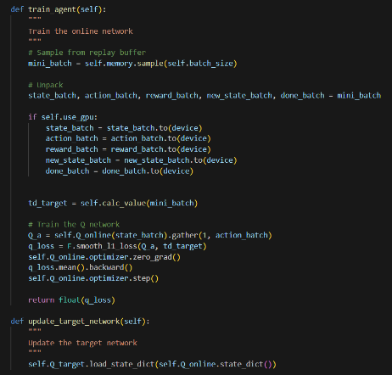
Double DQN VS Traditional DQN
Employs two separate Q-networks:
Online network - Action selection
Target network - Evaluate the selected network (ϵ-greedy policy)
Reduce overoptimism due to estimation errors seen in traditional DQN
Periodically, the target network will be updated with the weights of the online network.

Slide 13
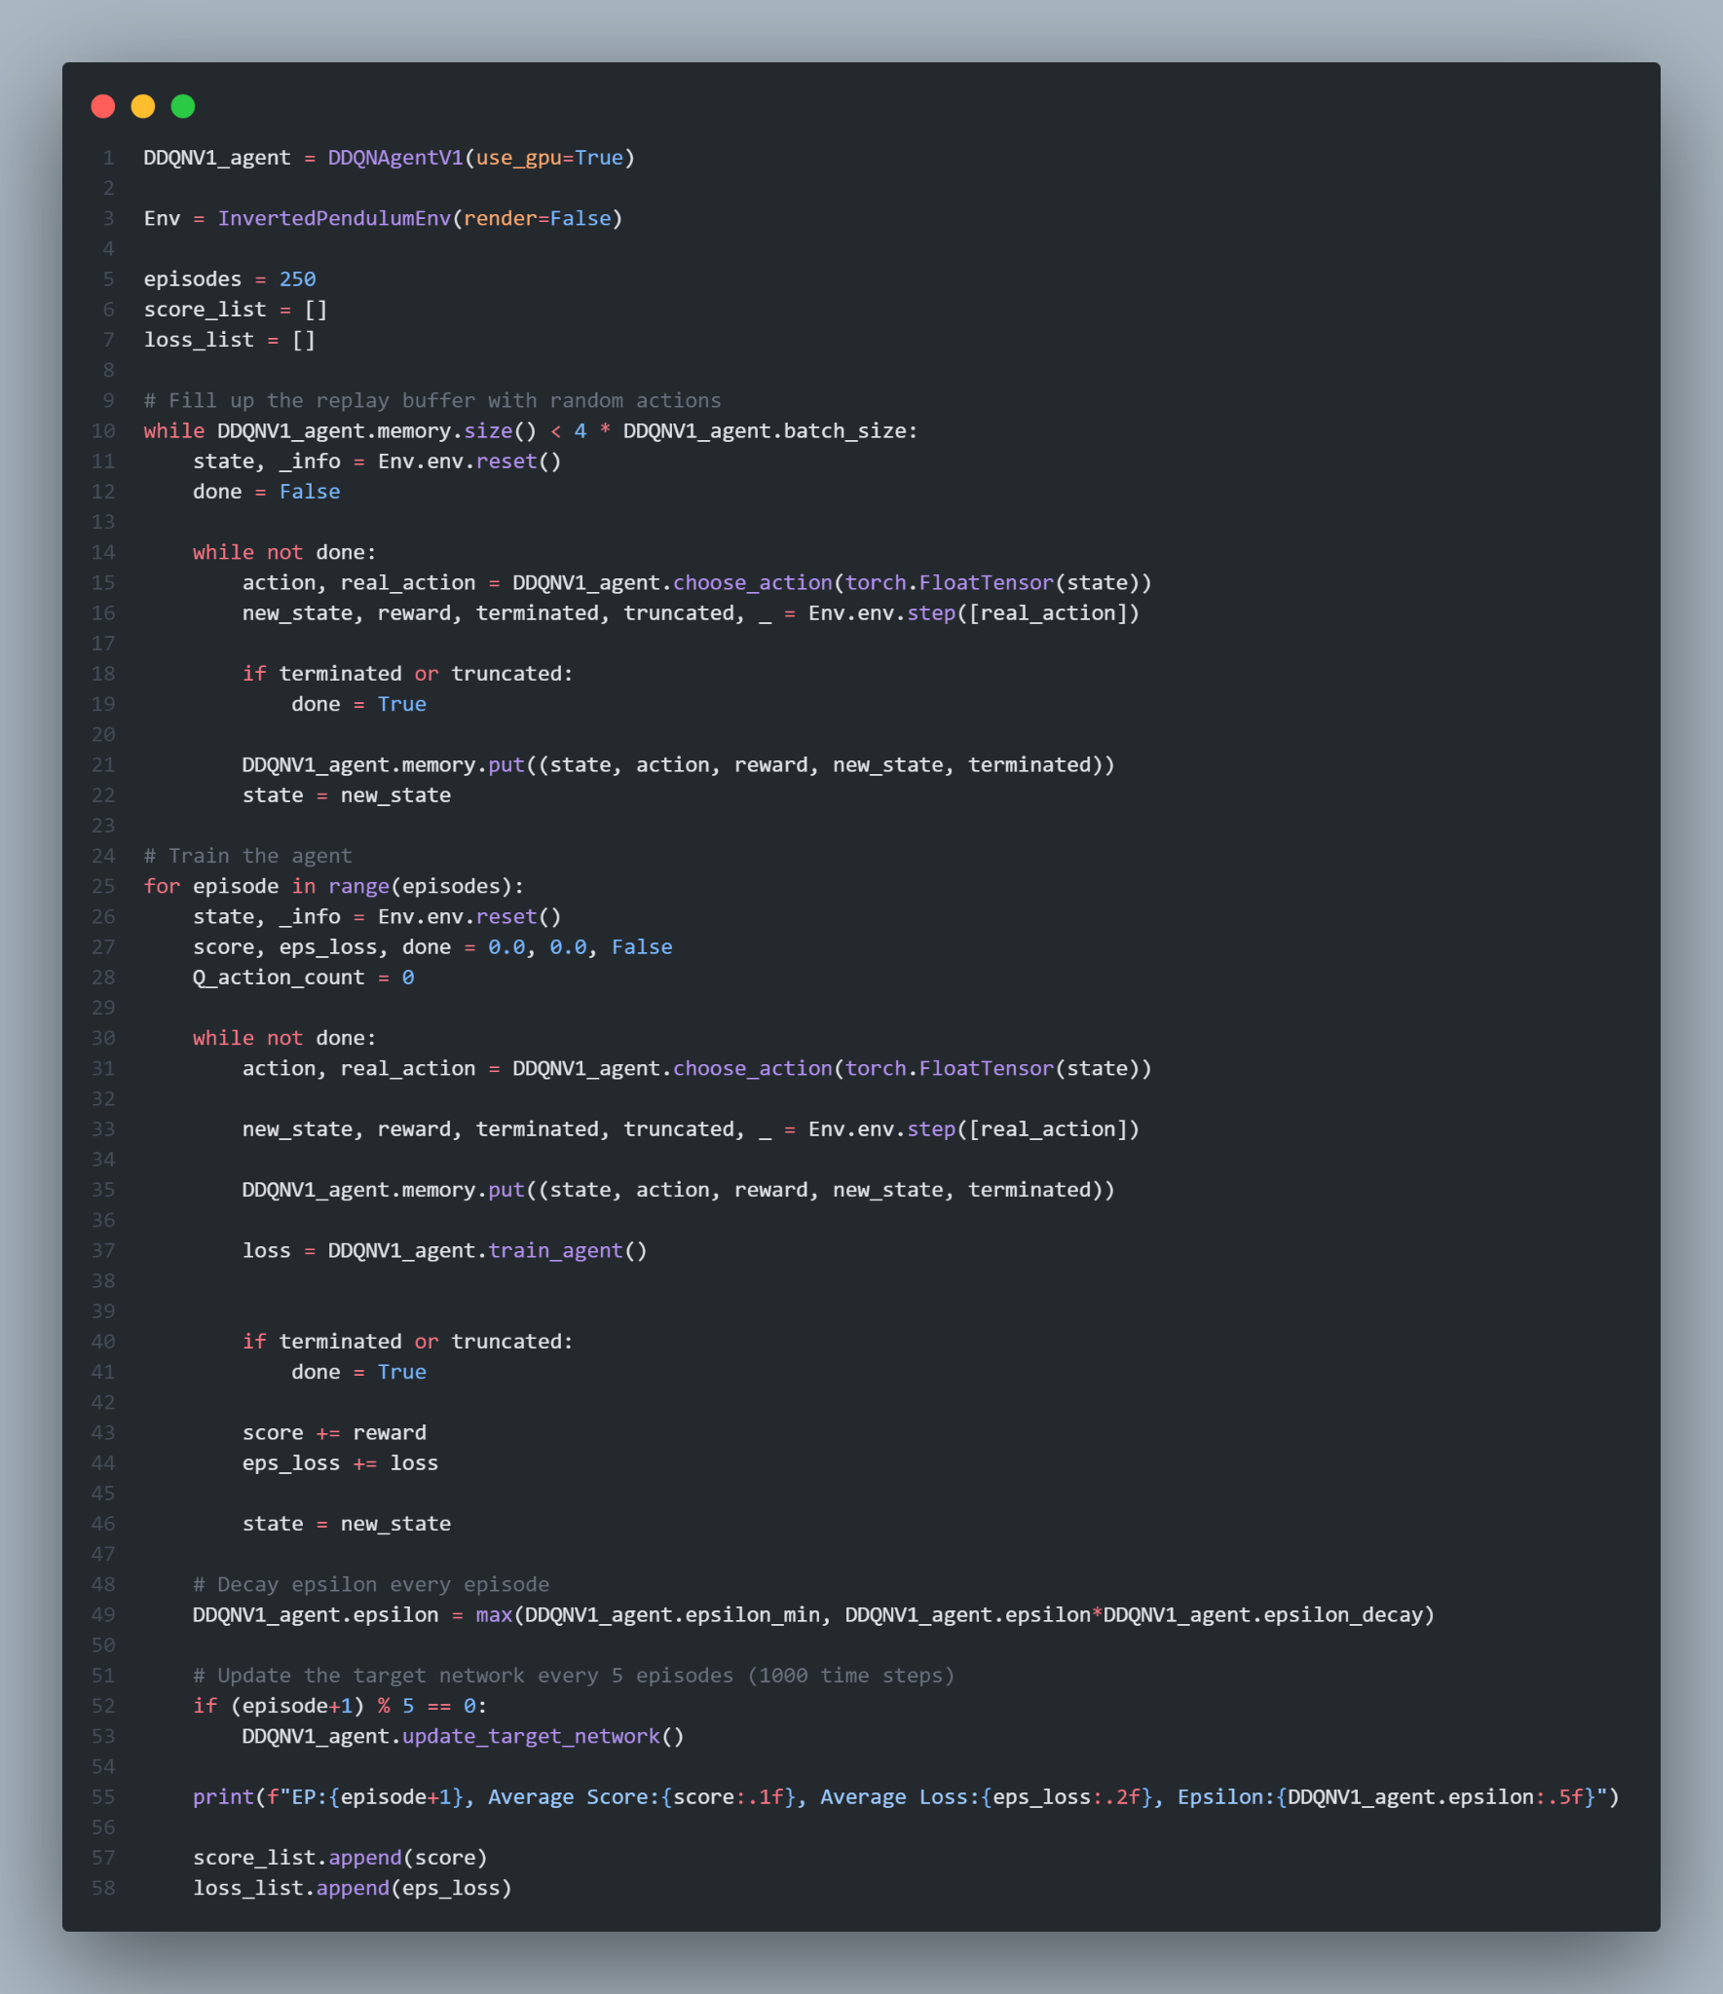
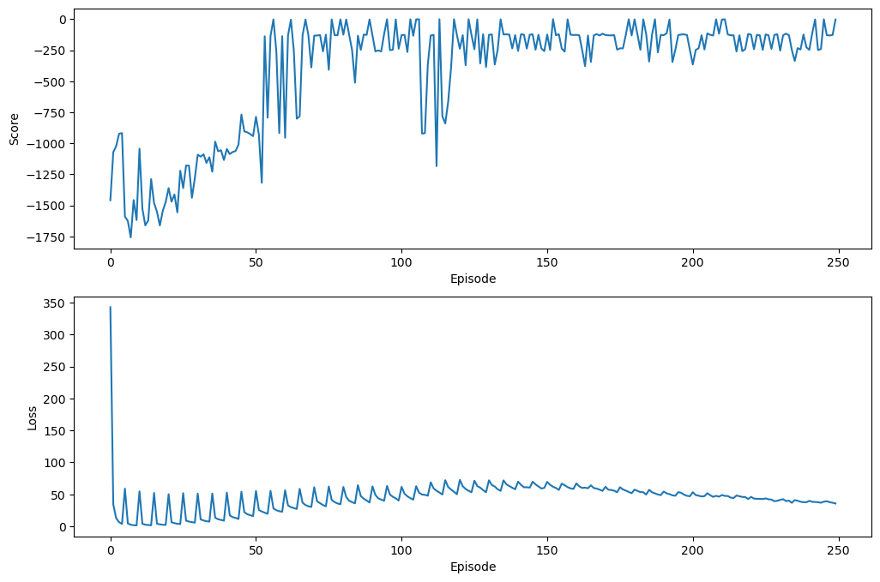
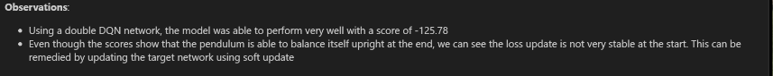
DDQNV1 (Training + Evaluation)
Result of 100 episodes: -125.78386020890338 ± 80.99884809895117

Slide 14
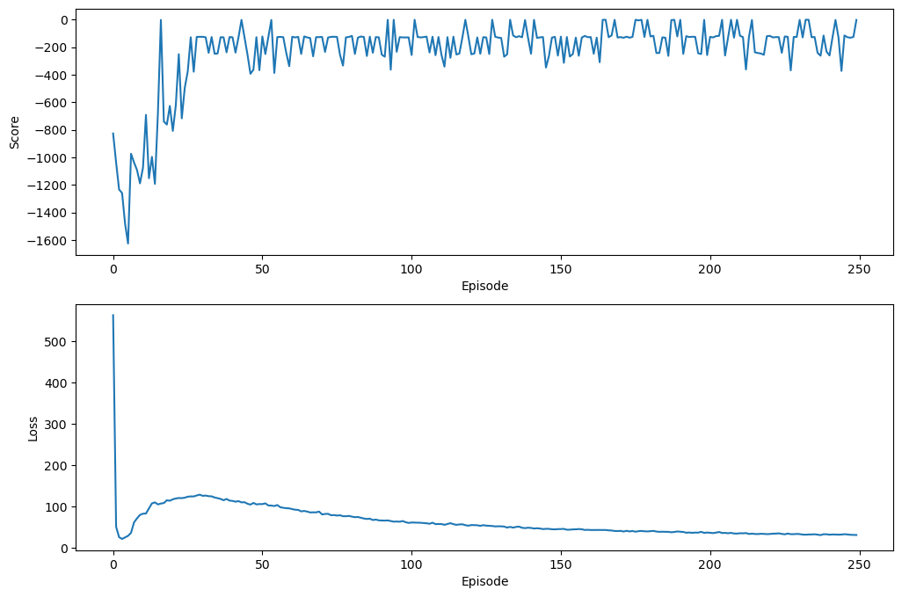
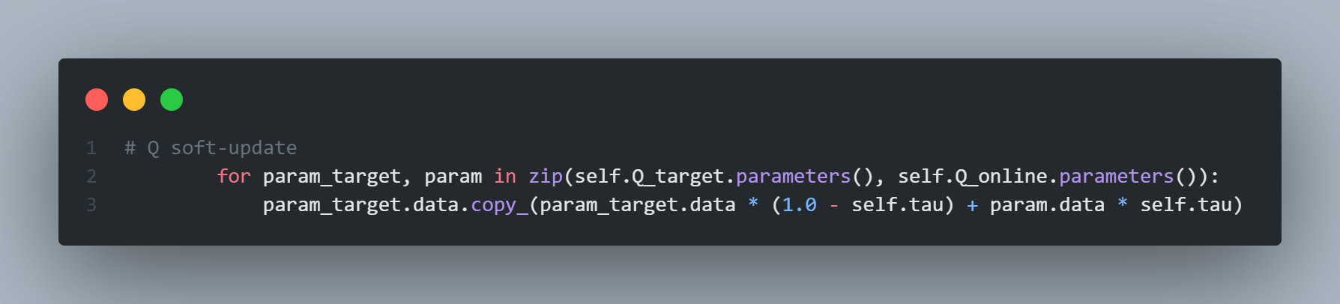
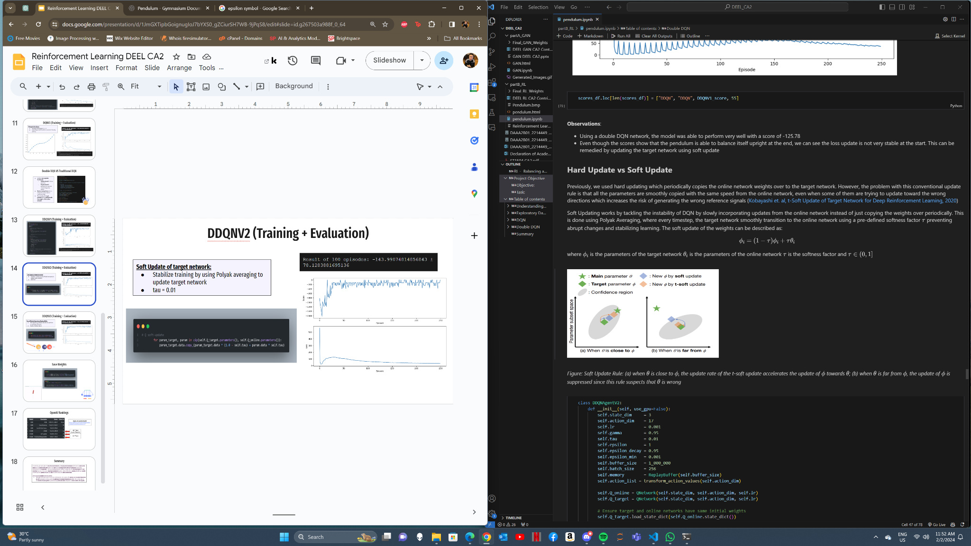
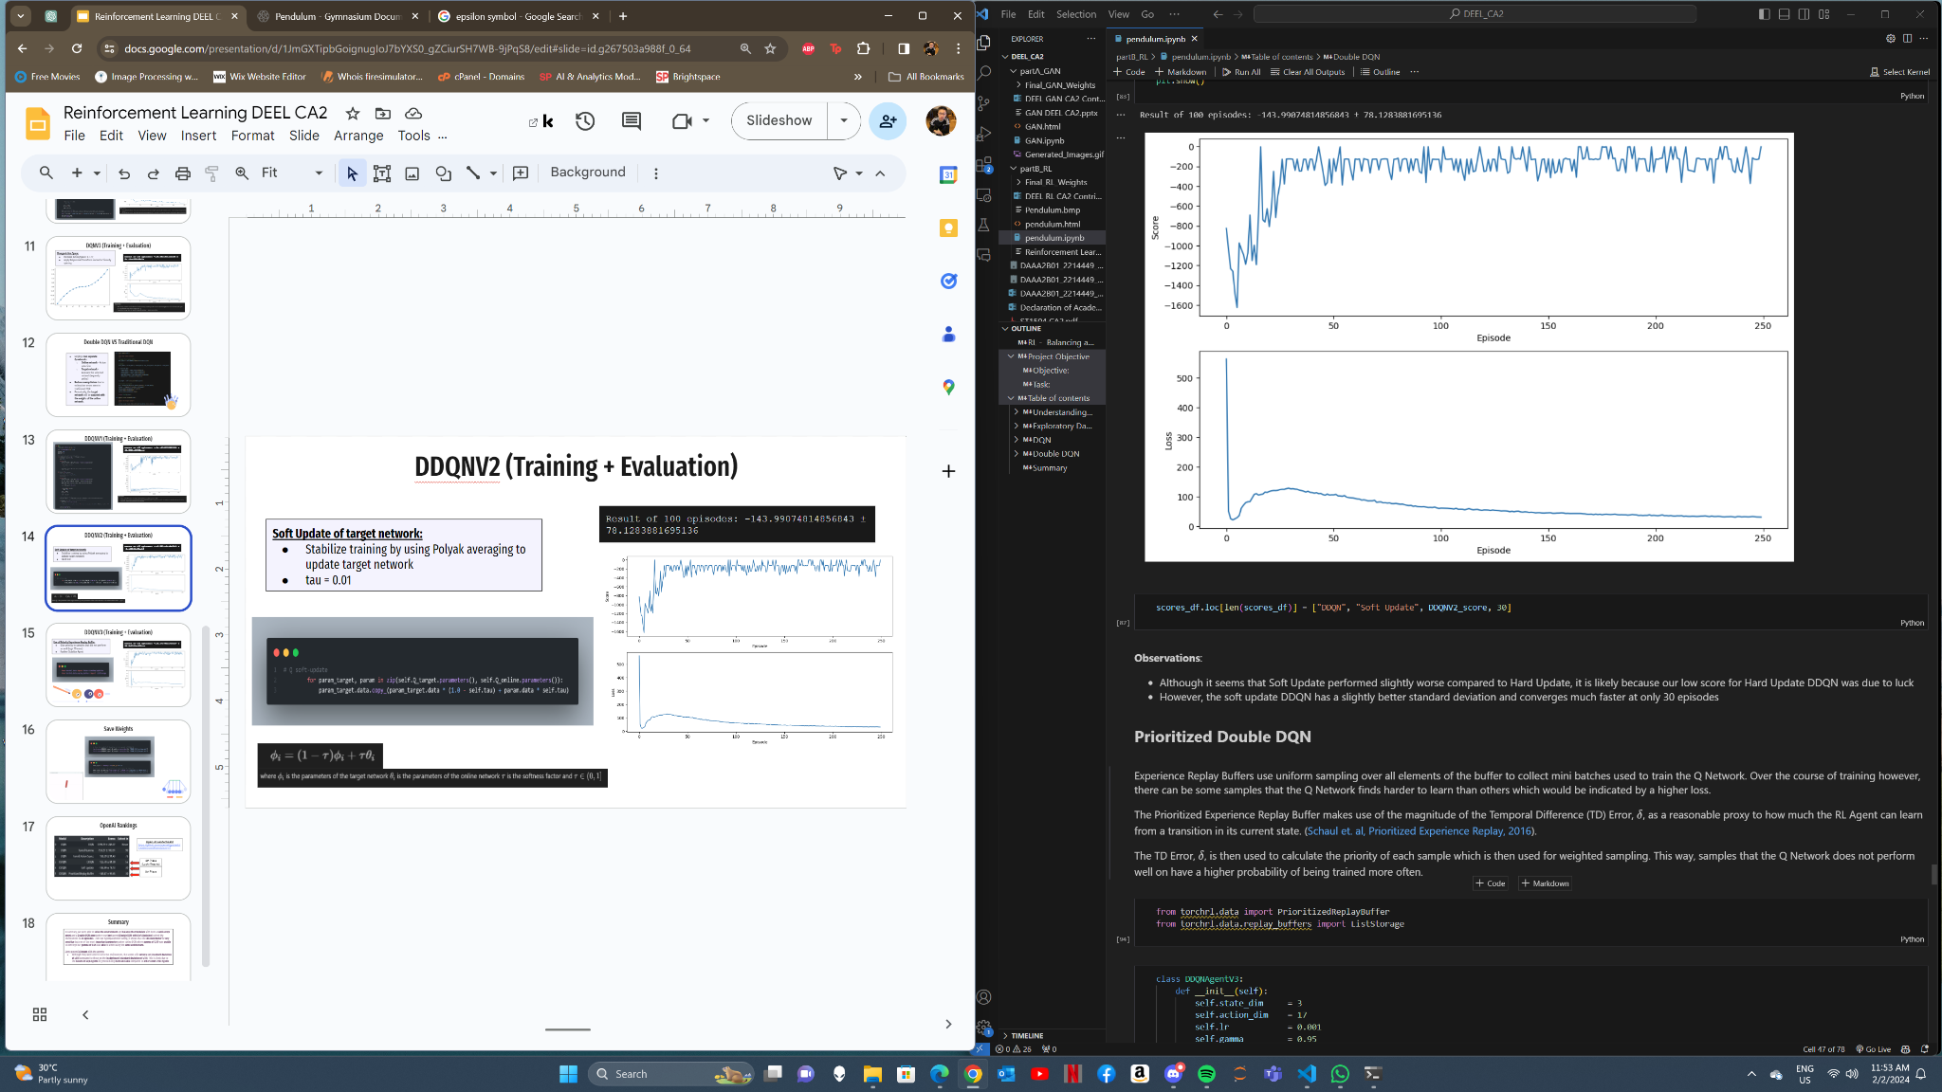
DDQNV2 (Training + Evaluation)
Result of 100 episodes: -143.99074814856843 ± 78.1283881695136
Soft Update of target network:
Stabilize training by using Polyak averaging to update target network
tau = 0.01

Slide 15
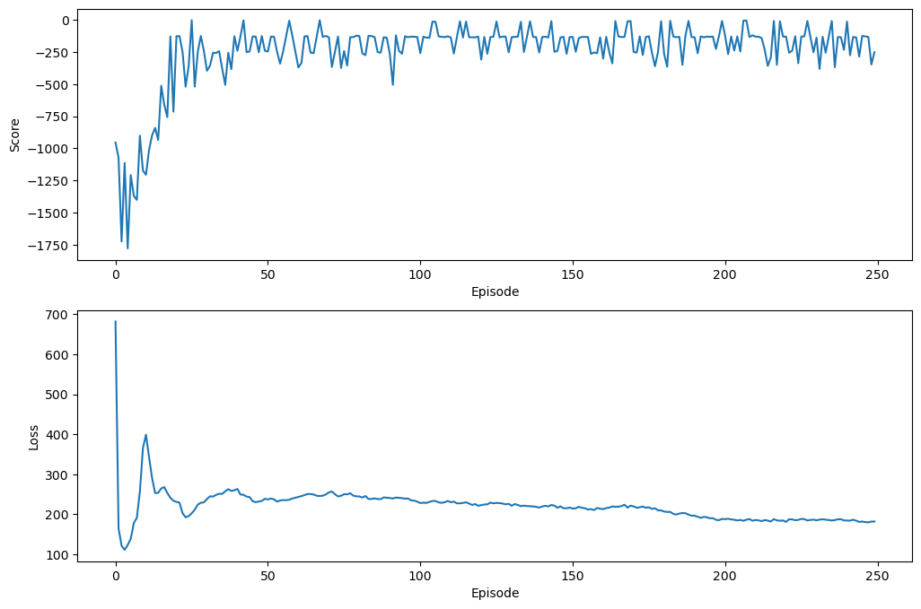
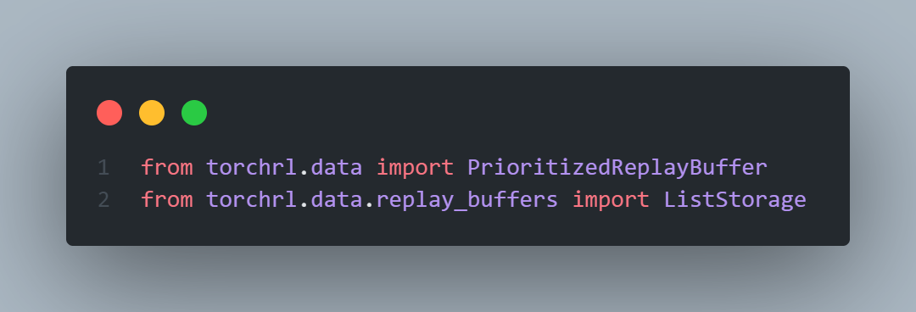
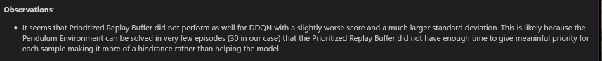
DDQNV3 (Training + Evaluation)
Use of Priority Experience Replay Buffer:
Give priority to samples that did not perform as well (high TD error)
Further Stabilize Agent
Result of 100 episodes: -148.47179351700527 ± 93.65330057623711

Slide 16
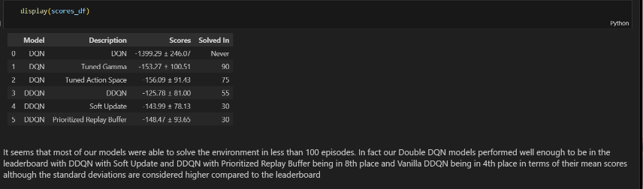
First Episode to Optimal Performance

Slide 17
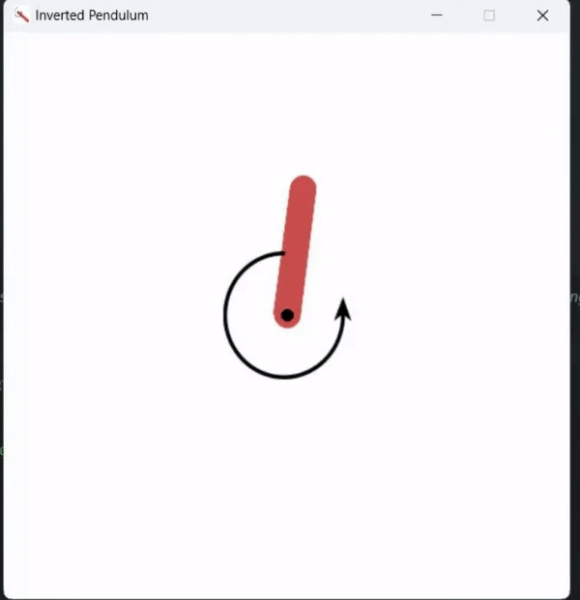
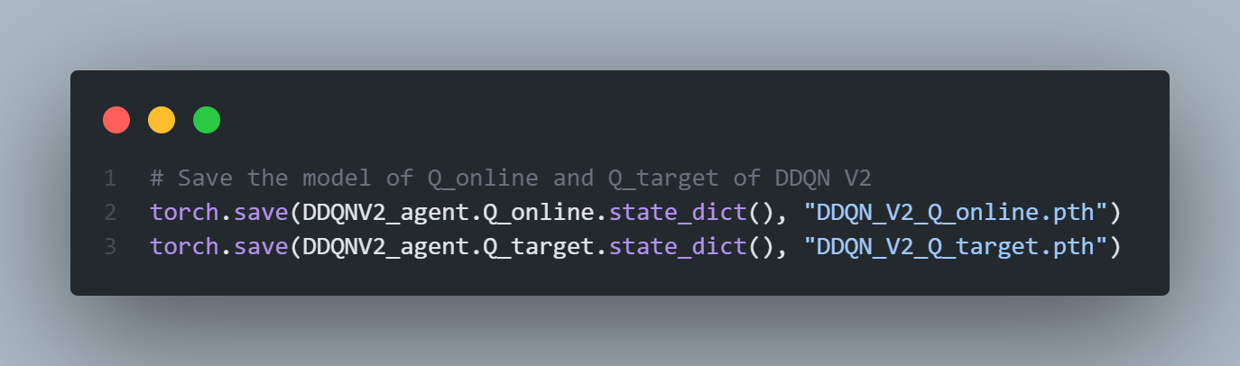
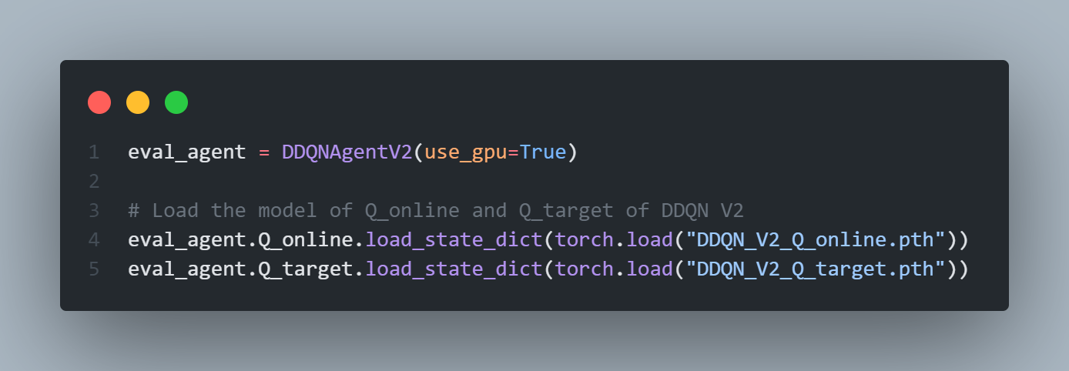
Final Model
Best Model - DDQNV2_agent:
Soft Update of Target Network

Slide 18
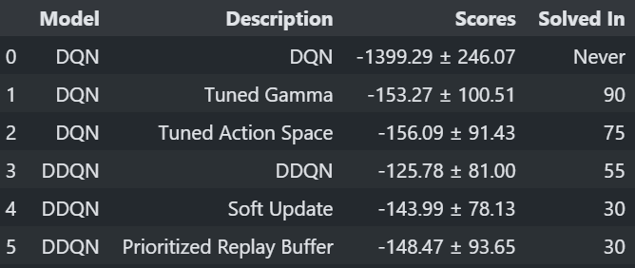
OpenAI Rankings
Open AI Leaderboard
https://github.com/openai/gym/wiki/
Leaderboard#pendulum-v0
4th Place (Lucky Results)
8th Place

Slide 19
Summary
In summary, we were able to solve the environment and balance the Pendulum with both a vanilla DQN agent and a Double DQN agent where our best agent (Double DQN with Soft Updating) solved the environment in 30 episodes. From our hyperparameter tuning, it shows that the discount factor is very sensitive but one of the most important parameters when tuning DQN where gamma of 0.99 was unable to converge but gamma of 0.95 was able to when using the same architecture.
Some potential issues with the agents:
Although they were able to solve the environment, the scores still varied a lot (standard deviation of ±80) compared to those on the leaderboard (standard deviation of ±10). This is likely due to the nature of DQN Agents in general being more unstable compared to other Actor Critic Agents

